Slide 1
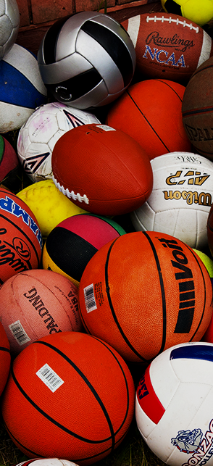
Sport Identification using
Ball Detection
Team Members
Ritika Lakdawala- 201801226
Nishtha Chaudhary- 201801235
Khushali Shah- 201801264

Slide 2

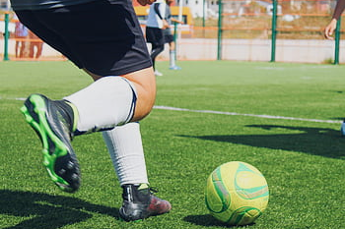
Problem Statement
The model should be able to identify the sport based on the type of ball; detected from the real-world image given as an input, using a multiclass classification based on supervised machine learning technique.
Model
Football

Slide 3





Block Schematic
Labelling
Assign labels to images
Dataset Splitting
Splitting data into Training, Testing and Validation sets
Data Preprocessing Data formatting
Data cleaning (image resizing)
Image Segmentation
CHT - Circle detection
Data Collection
Collection of datasets from Kaggle
Notes:
Why do we need Data Preprocessing?
A real-world data generally contains noises, missing values, and maybe in an unusable format which cannot be directly used for machine learning models. Data preprocessing is required tasks for cleaning the data and making it suitable for a machine learning model which also increases the accuracy and efficiency of a machine learning model.
Image Segmentation is the process by which a digital image is partitioned into various subgroups (of pixels) called Image Objects, which can reduce the complexity of the image, and thus analyzing the image becomes simpler.
https://www.analytixlabs.co.in/blog/what-is-image-segmentation/
CHT- detecting circles in imperfect images
YOLO, Faster R-CNN
Mask rcnn, unet , segnet and cht

Slide 4





Contd.
Feature Extraction
SIFT, CSIFT
Data Visualization
Analyzing statistics
Testing & Performance Analysis
Confusion matrix
Feature Selection
Modeling
Multi-class classification
KNN, ReLu, CNN, SVM
Notes:
the idea of extracting useful features which clearly define the objects in the image.
SIFT – Scale-Invariant Feature Transform – Overfitting, regularization, dimentionality reduction
Extrema detection
Keypoint Localizaion
Orientation assignment
Keypoint descriptor
Data visualization – Scatter, Box, Histogram – Matplotlib, seaborn, ploty
ReLu - rectified linear unit
Recursive feature elimination

Slide 5
DataSets
Following are the links to the kaggle datasets for the sports
Baseball, Basketball, Cricket, Football, Hockey, Table tennis, Tennis, Volleyball:
https://www.kaggle.com/ponrajsubramaniian/sportclassificationdataset
Soccer, Baseball, Basketball and Golf:
https://www.kaggle.com/ch2y0ung/classify-sports
Rugby and Soccer:
https://www.kaggle.com/ligtfeather/football-vs-rugby-image-classification

Slide 6
References
Distinctive Image Features from Scale-Invariant Keypoints, David G. Lowe https://link.springer.com/article/10.1023/B:VISI.0000029664.99615.94
Multi-class multi-level classification algorithm, Nazia Hameed, Antesar M. Shabut, Miltu K. Ghosh, M.A. Hossain - https://www.sciencedirect.com/science/article/abs/pii/S0957417419306797
Ball detection in static images with Support Vector Machines, N. Ancona, G. Cicirelli, E. Stella, A. Distante https://www.sciencedirect.com/science/article/abs/pii/S0262885603000635
Yang, W. Analysis of sports image detection technology based on machine learning. J Image Video Proc. 2019, 17 (2019). https://doi.org/10.1186/s13640-019-0409-8
Ketan Joshi, Vikas Tripathi, Chitransh Bose, Chaitanya Bhardwaj, Robust Sports Image Classification Using InceptionV3 and Neural Networks,Procedia Computer Science, Volume 167, 2020, Pages 2374-2381, ISSN 1877-0509, https://doi.org/10.1016/j.procs.2020.03.290
https://medium.com/@sreekaranne000/classification-of-sports-balls-using-different-learning-algorithms-87ab19be784d
https://www.analyticsvidhya.com/blog/2019/04/introduction-image-segmentation-techniques-python/

